Slide 1
Learn from azure

Slide 2
Introducing Big Data
Device Explosion
Social Networks
Cheap Storage
$100 get you 3 million times more storage in 30 years
>5.5 billion (70+% of global population)
>2 billion users
Ubiquitous Connections
Sensor Networks
Cheap Storage
Web traffic
2010 130 Exabyte (10E18)
2015 1.6 Zettabyte(10E21)
>10 billion
1980 10MIPS/$
2005 10M MIPS/$

Slide 3
网站流量统计
Admaster
http://www.admaster.com.cn/
Capptain
http://www.capptain.com/
Google Analytics
http://www.google.cn/intl/zh-CN_ALL/analytics/index.html
百度统计
http://tongji.baidu.com/

Slide 4
问题场景
广告被曝光次数，广告被点击次数
他们对我的广告、推广的产品与网站是否感兴趣
整个广告项目覆盖了目标受众情况，人群属性如何
项目的实际效果如何，品牌喜好度，购买倾向是否提升

Slide 5
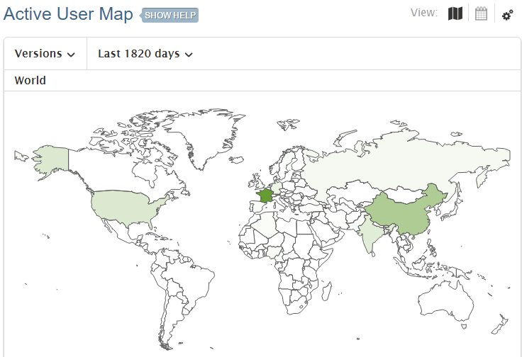
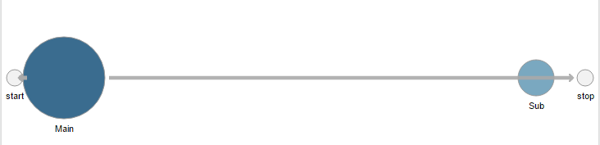
Capptain
Users
New, Active, Retained, Tracking, Tracking per Source, Tracking per Store
Retention
Sessions
count, length
Activities
Count, length
User Path*
Events
Per user, per session, per job
Jobs
Technical
Carriers, Devices, Firmware, Networks, version, locales, screen, SDKs
Errors
Creashes

Slide 6
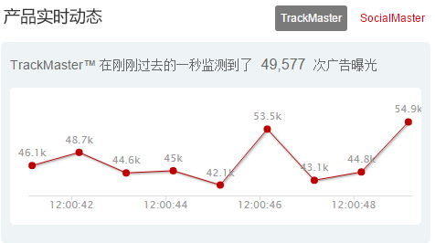
AdMaster
广告转化
调研分析
社会化营销
电商分析
跨屏分析
数据可视化
大数据平台

Slide 7
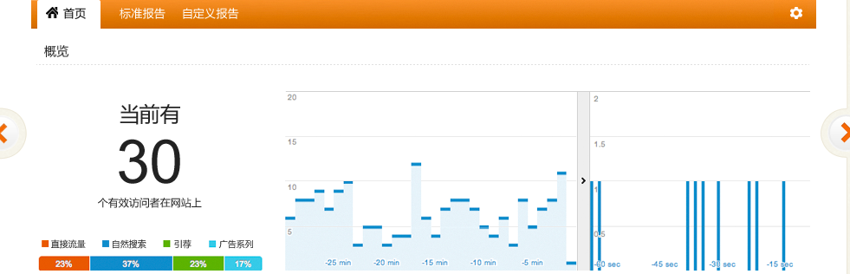
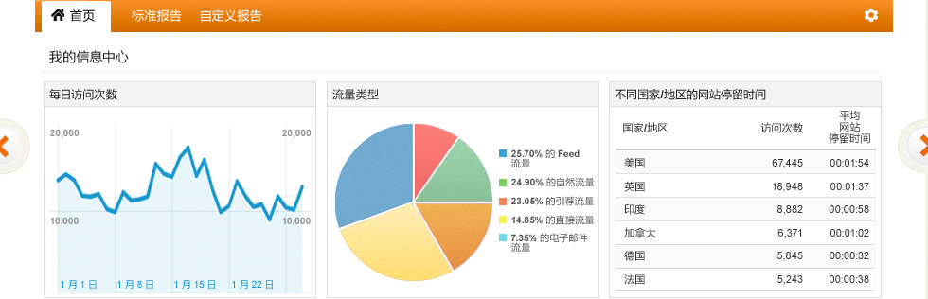
Google Analytics
内容分析
移动分析
转化分析
社交分析
广告分析

